Slide 1
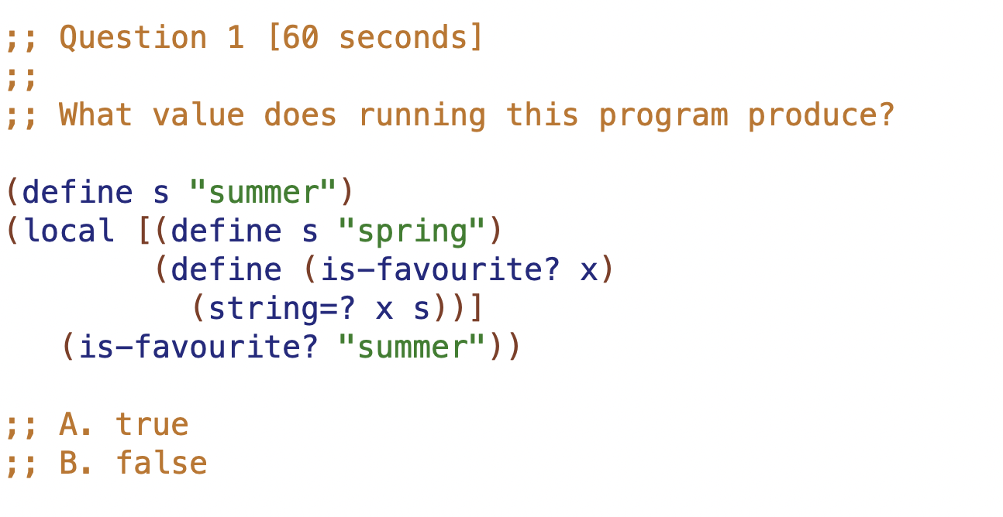

Slide 2
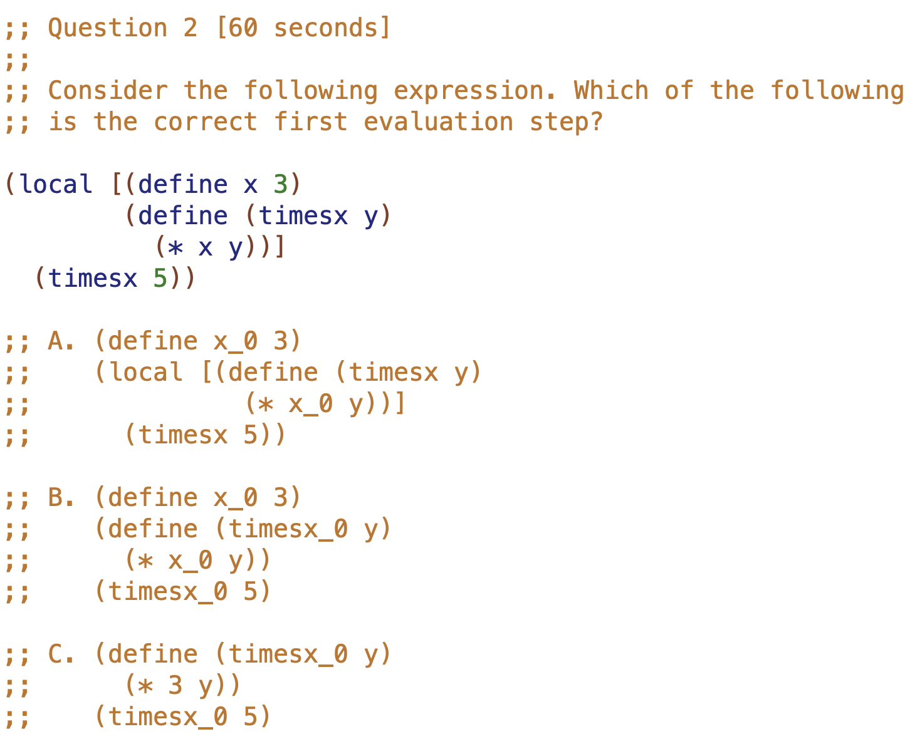

Slide 3
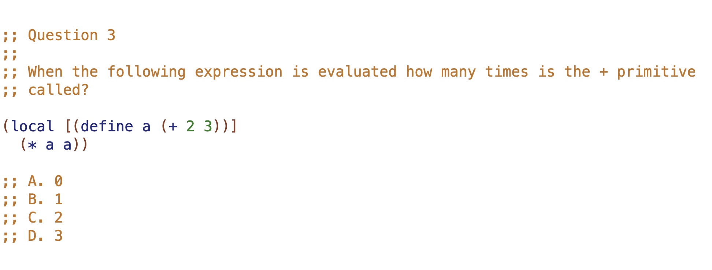

Slide 4
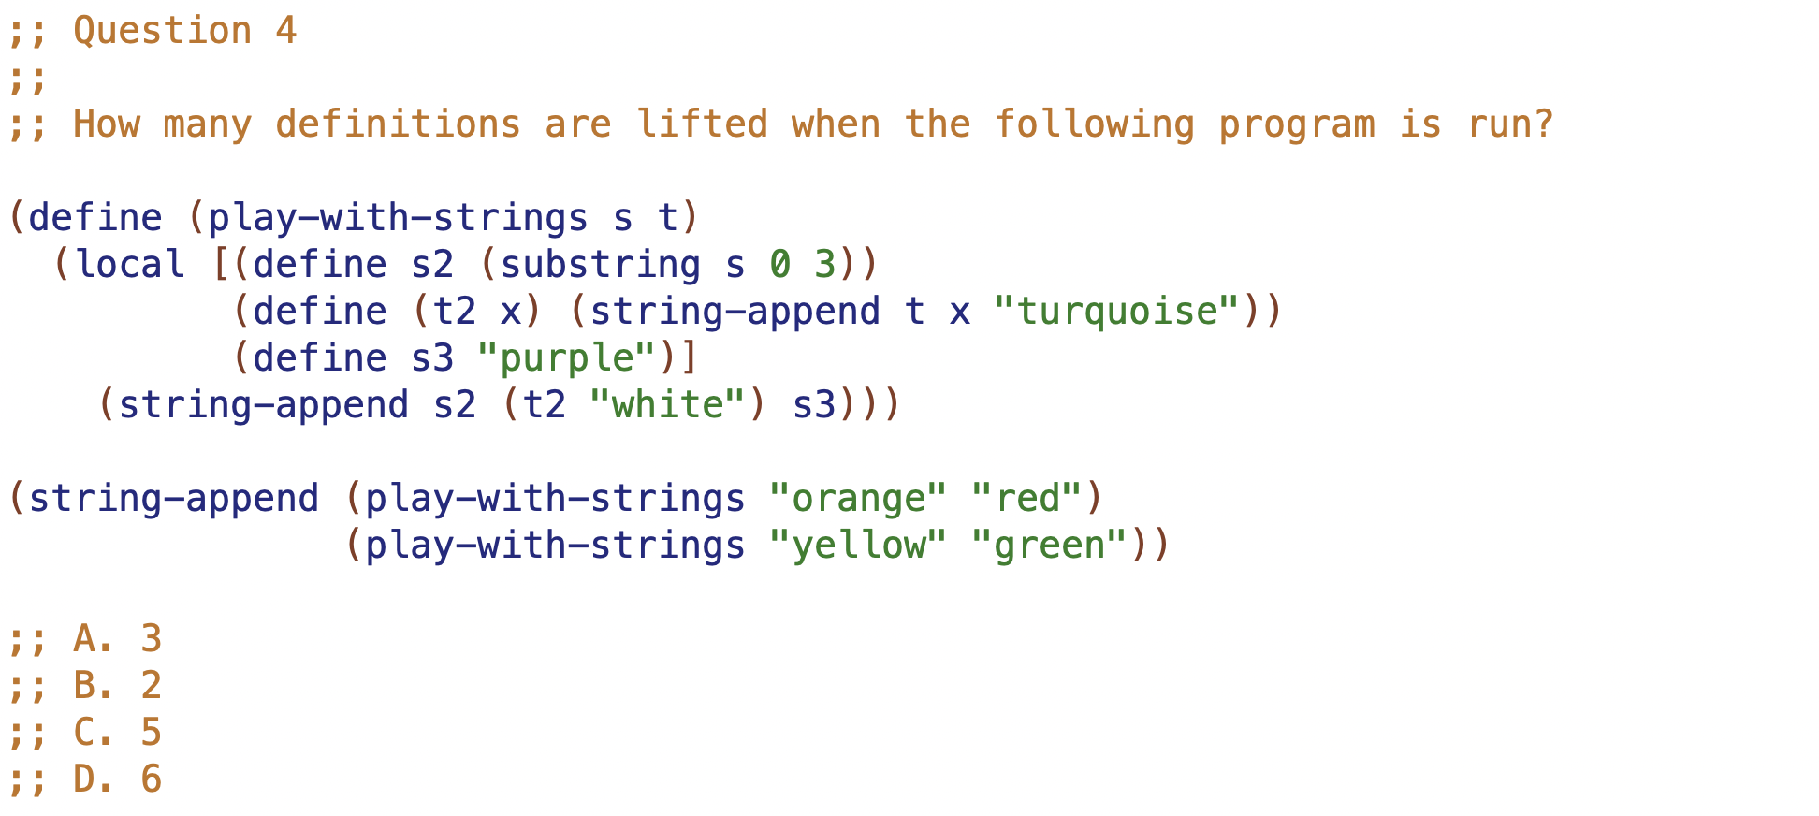

Slide 5
3 ways to use local:
eliminate identical recursive calls
encapsulate 2 or more definitions
improve code clarity by giving names to intermediate values
refactoring
a fundamental technique for improving code
take a correct running program, refactor to improve structure
3 ways to use local - either via refactoring, or when initially writing code
 | Eliminate… | Encapsulate 2… | Give names to vals
Via refactoring
While originally writing code

Slide 6
42:ily
27:wit
50:dug
14:olp
52:dug
…
___
…

Slide 7
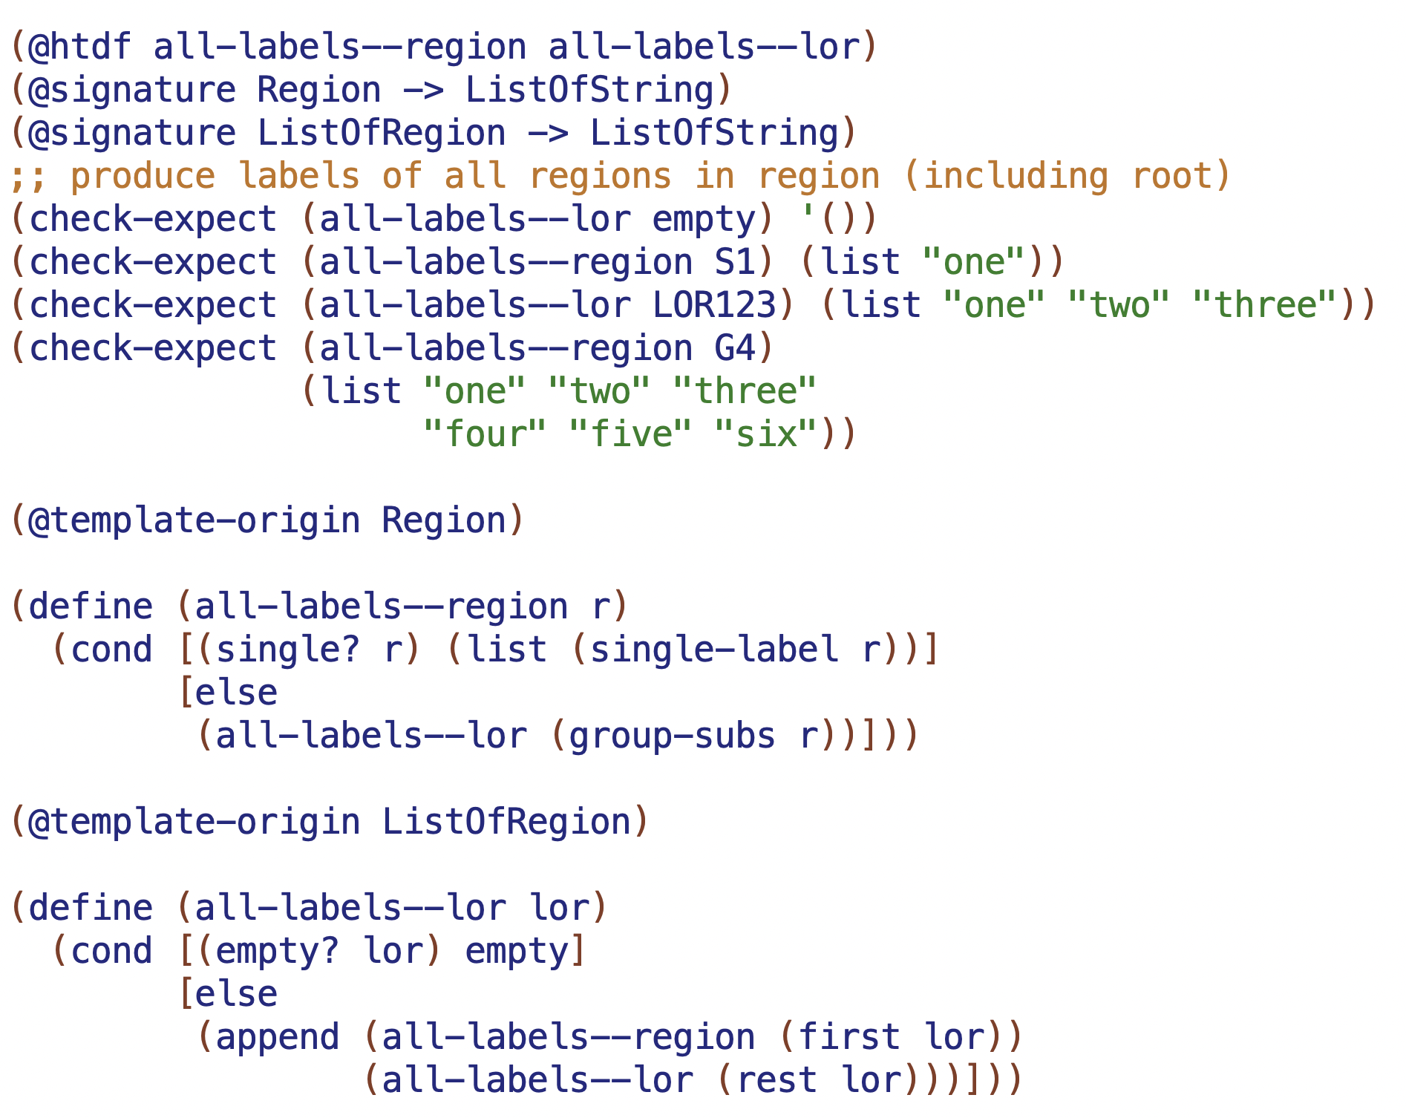

Slide 8
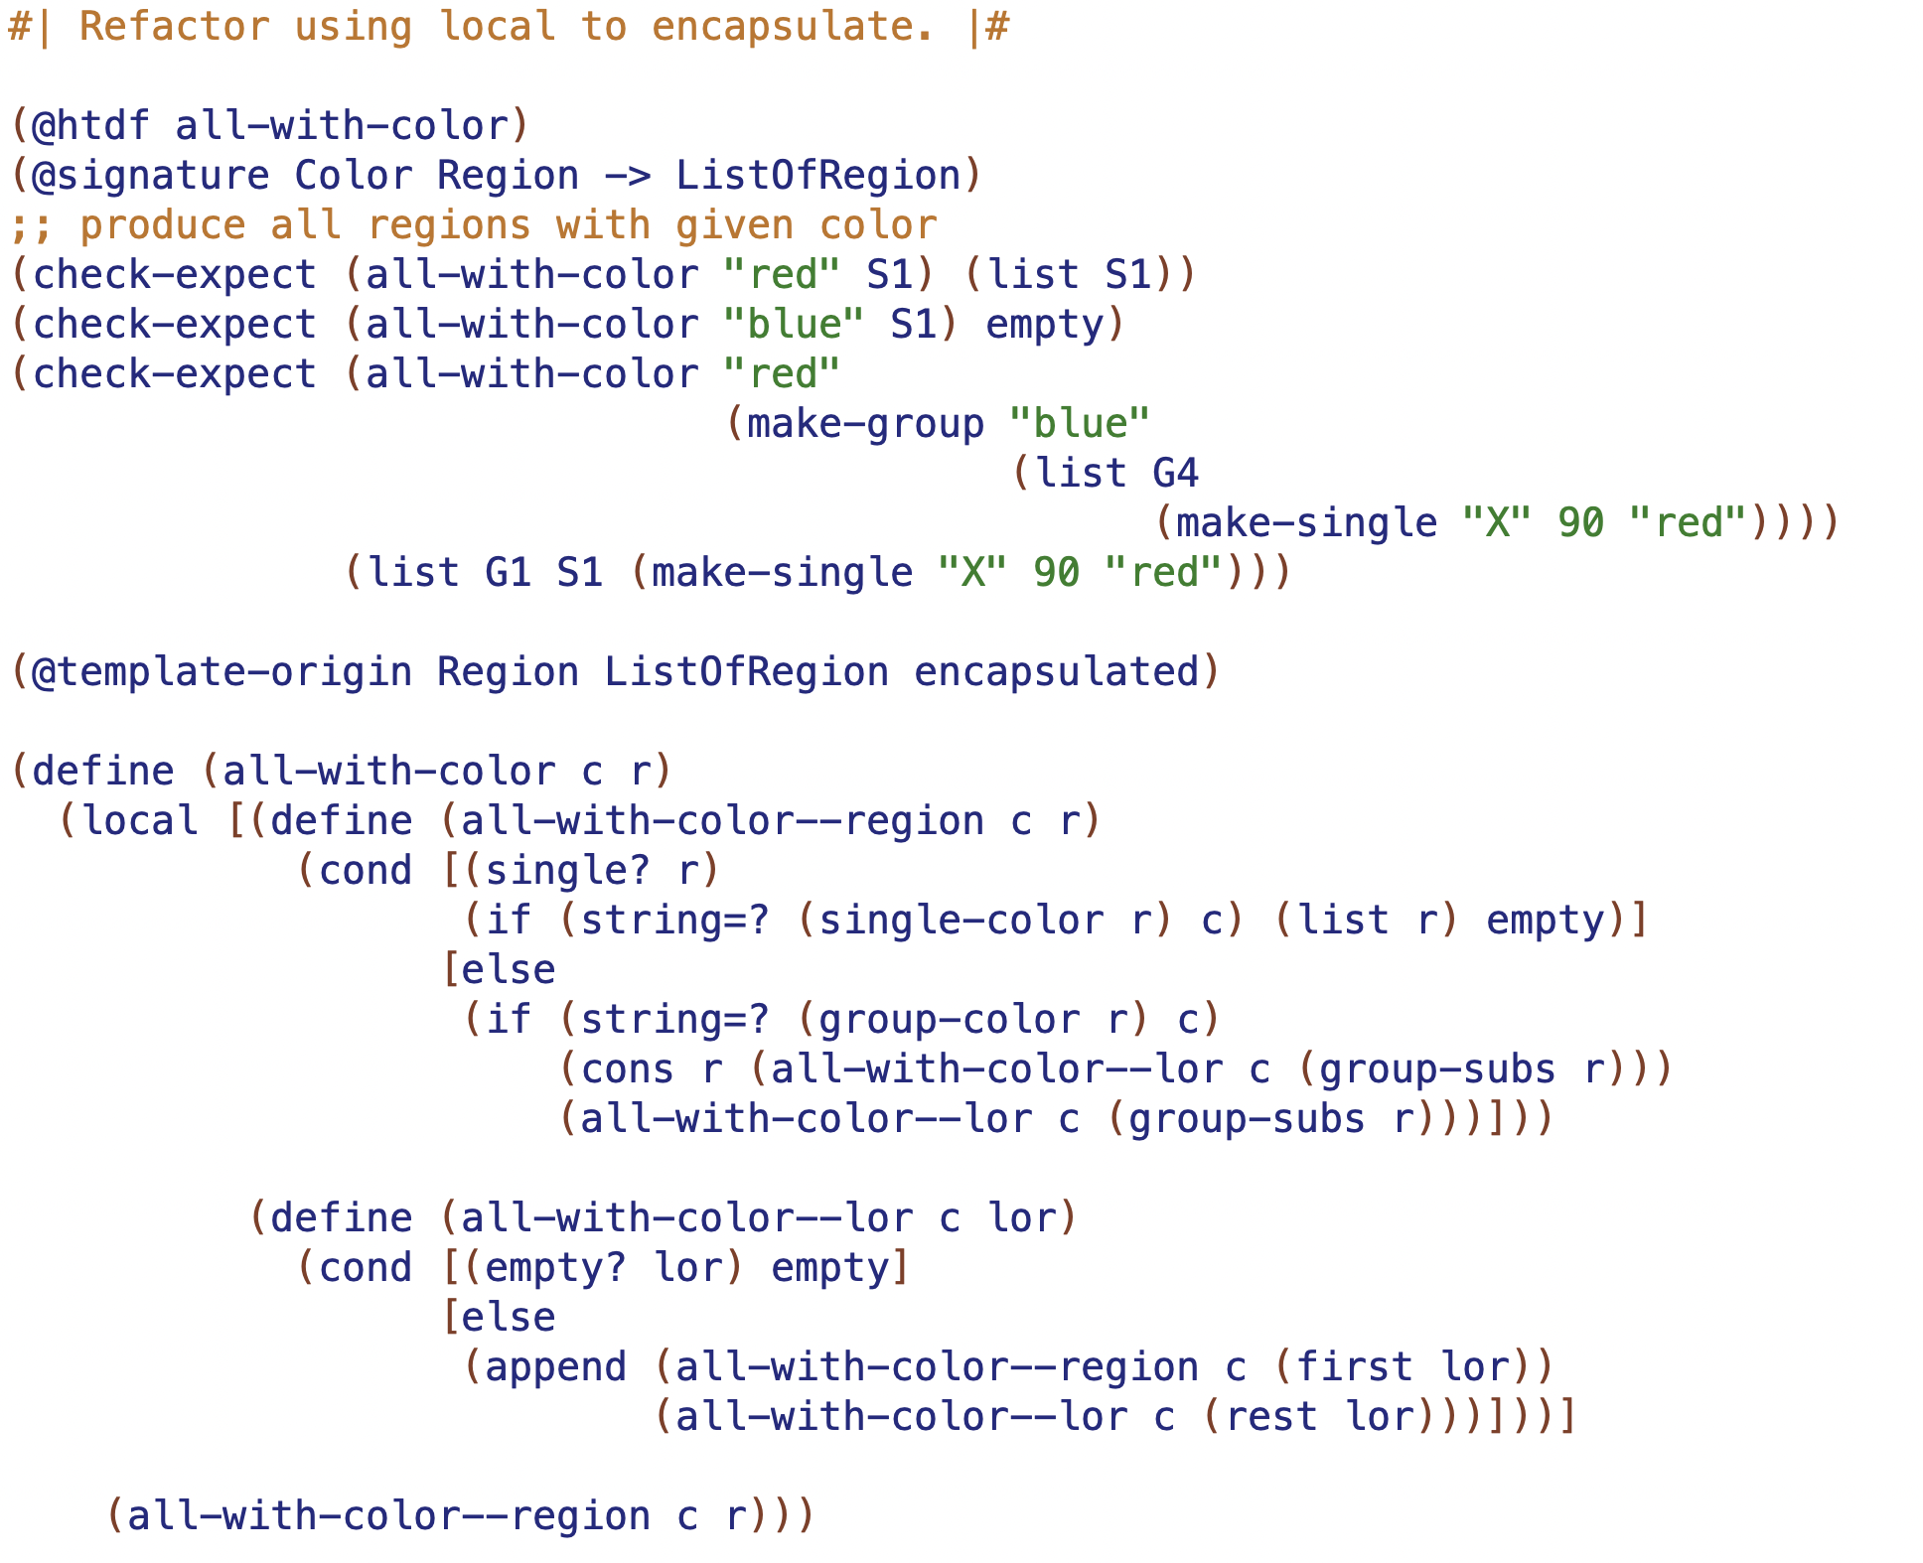

Slide 9
